Slide 1
MONEY MATTERS:A PERSONAL FINANCE MANAGEMENT APP
M.MITHUNA
812122104022

Slide 2
DESCRIPTION
The app allows user to keep track of their expenses and accounts, and provides anoverview of their financial status.Users can set a budget for various expenses and view their progress towards it.Money Matters is an intuitive personal finance management app designed to help individuals and families take control of their financial well-being. The app allows users to track income, expenses, savings, and investments with ease, offering a clear picture of their financial health. With customizable budgeting tools, users can set spending limits, monitor progress, and receive alerts to stay on track. Money Matters also enables users to set and achieve financial goals, such as saving for a vacation or paying off debt, with actionable insights and visual progress trackers. Money Matters empowers users to manage their money confidently and achieve long-term financial success.

Slide 3
PROGRAM:
import android.annotation.SuppressLint
import android.content.Intent
import android.os.Bundle
import androidx.activity.ComponentActivity
import androidx.activity.compose.setContent
import androidx.compose.foundation.Image
import androidx.compose.foundation.layout.*
import androidx.compose.material.*
import androidx.compose.runtime.*
import androidx.compose.ui.Alignment
import androidx.compose.ui.Modifier
import androidx.compose.ui.graphics.Color
import androidx.compose.ui.res.painterResource
import androidx.compose.ui.text.font.FontWeight
import androidx.compose.ui.text.style.TextAlign
import androidx.compose.ui.tooling.preview.Preview
import androidx.compose.ui.unit.dp
import androidx.compose.ui.unit.sp
import com.example.expensestracker.ui.theme.ExpensesTrackerTheme

Slide 4
class MainActivity : ComponentActivity() {
@SuppressLint("UnusedMaterialScaffoldPaddingParameter")
override fun onCreate(savedInstanceState: Bundle?) {
super.onCreate(savedInstanceState)
setContent {
Scaffold(
// in scaffold we are specifying top bar.
bottomBar = {
// inside top bar we are specifying
// background color.
BottomAppBar(backgroundColor = Color(0xFFadbef4),
modifier = Modifier.height(80.dp),
// along with that we are specifying
// title for our top bar.
content = {
Spacer(modifier = Modifier.width(15.dp))
Button(
onClick = {startActivity(Intent(applicationContext,AddExpensesActivity::class.java))},
colorsButtonDefaults.buttonColors(backgroundColor=Color.White),

Slide 5
modifier = Modifier.size(height = 55.dp, width = 110.dp)
)
{
Text(
text = "Add Expenses", color = Color.Black, fontSize = 14.sp,
textAlign = TextAlign.Center
)
}
Spacer(modifier = Modifier.width(15.dp))
Button(
onClick = {
startActivity(
Intent(
applicationContext,
SetLimitActivity::class.java
)
)
},
colors = ButtonDefaults.buttonColors(backgroundColor = Color.White),
modifier = Modifier.size(height = 55.dp, width = 110.dp)
)

Slide 6
{
Text(
text = "Set Limit", color = Color.Black, fontSize = 14.sp,
textAlign = TextAlign.Center
)
}
Spacer(modifier = Modifier.width(15.dp))
Button(
onClick = {
startActivity(
Intent(
applicationContext,
ViewRecordsActivity::class.java
)
)
},
colors = ButtonDefaults.buttonColors(backgroundColor = Color.White),
modifier = Modifier.size(height = 55.dp, width = 110.dp)
)
}

Slide 7
{
Text(
text = "View Records", color = Color.Black, fontSize = 14.sp,
textAlign = TextAlign.Center
)
}
}
)
}
) {
MainPage()
}
}
}
}
@Composable
fun MainPage() {
Column(
modifier = Modifier.padding(20.dp).fillMaxSize(),
verticalArrangement = Arrangement.Center,
horizontalAlignment = Alignment.CenterHorizontally

Slide 8
{
Text(text = "Welcome To Expense Tracker", fontSize = 42.sp, fontWeight = FontWeight.Bold,
textAlign = TextAlign.Center)
Image(painterResource(id = R.drawable.img_1), contentDescription ="", modifier = Modifier.size(height = 500.dp, width = 500.dp))
}
}

Slide 9
REGISTER ACTIVITY:
class RegisterActivity : ComponentActivity() {
private lateinit var databaseHelper: UserDatabaseHelper
override fun onCreate(savedInstanceState: Bundle?) {
super.onCreate(savedInstanceState)
databaseHelper = UserDatabaseHelper(this)
setContent {
ExpensesTrackerTheme {
// A surface container using the 'background' color from the theme
Surface(
modifier = Modifier.fillMaxSize(),
color = MaterialTheme.colors.background
) {
RegistrationScreen(this,databaseHelper)
}
}
}
}
}

Slide 10
@Composable
fun RegistrationScreen(context: Context, databaseHelper: UserDatabaseHelper) {
Image(
painterResource(id = R.drawable.img_1), contentDescription = "",
alpha =0.3F,
contentScale = ContentScale.FillHeight,
)
var username by remember { mutableStateOf("") }
var password by remember { mutableStateOf("") }
var email by remember { mutableStateOf("") }
var error by remember { mutableStateOf("") }
Column(
modifier = Modifier.fillMaxSize(),
horizontalAlignment = Alignment.CenterHorizontally,
verticalArrangement = Arrangement.Center
) {
Text(
fontSize = 36.sp,

Slide 11
fontWeight = FontWeight.ExtraBold,
fontFamily = FontFamily.Cursive,
color = Color.White,
text = "Register"
)
Spacer(modifier = Modifier.height(10.dp))
TextField(
value = username,
onValueChange = { username = it },
label = { Text("Username") },
modifier = Modifier
.padding(10.dp)
.width(280.dp)
)
TextField(
value = email,
onValueChange = { email = it },
label = { Text("Email") },
modifier = Modifier

Slide 12
.padding(10.dp)
.width(280.dp)
)
TextField(
value = password,
onValueChange = { password = it },
label = { Text("Password") },
modifier = Modifier
.padding(10.dp)
.width(280.dp),
visualTransformation = PasswordVisualTransformation()
)
if (error.isNotEmpty()) {
Text(
text = error,
color = MaterialTheme.colors.error,
modifier = Modifier.padding(vertical = 16.dp)
)
}

Slide 13
Button(
onClick = {
if (username.isNotEmpty() && password.isNotEmpty() && email.isNotEmpty()) {
val user = User(
id = null,
firstName = username,
lastName = null,
email = email,
password = password
)
databaseHelper.insertUser(user)
error = "User registered successfully"
// Start LoginActivity using the current context
context.startActivity(
Intent(
context,
LoginActivity::class.java
)
)
} else {
error = "Please fill all fields"
}

Slide 14
modifier = Modifier.padding(top = 16.dp)
) {
Text(text = "Register")
}
Spacer(modifier = Modifier.width(10.dp))
Spacer(modifier = Modifier.height(10.dp))
Row() {
Text(
modifier = Modifier.padding(top = 14.dp), text = "Have an account?"
)
TextButton(onClick = {
context.startActivity(
Intent(
context,
LoginActivity::class.java
)
)
}
)

Slide 15
{
Spacer(modifier = Modifier.width(10.dp))
Text(text = "Log in")
}
}
}
}
private fun startLoginActivity(context: Context) {
val intent = Intent(context, LoginActivity::class.java)
ContextCompat.startActivity(context, intent, null)
}

Slide 16
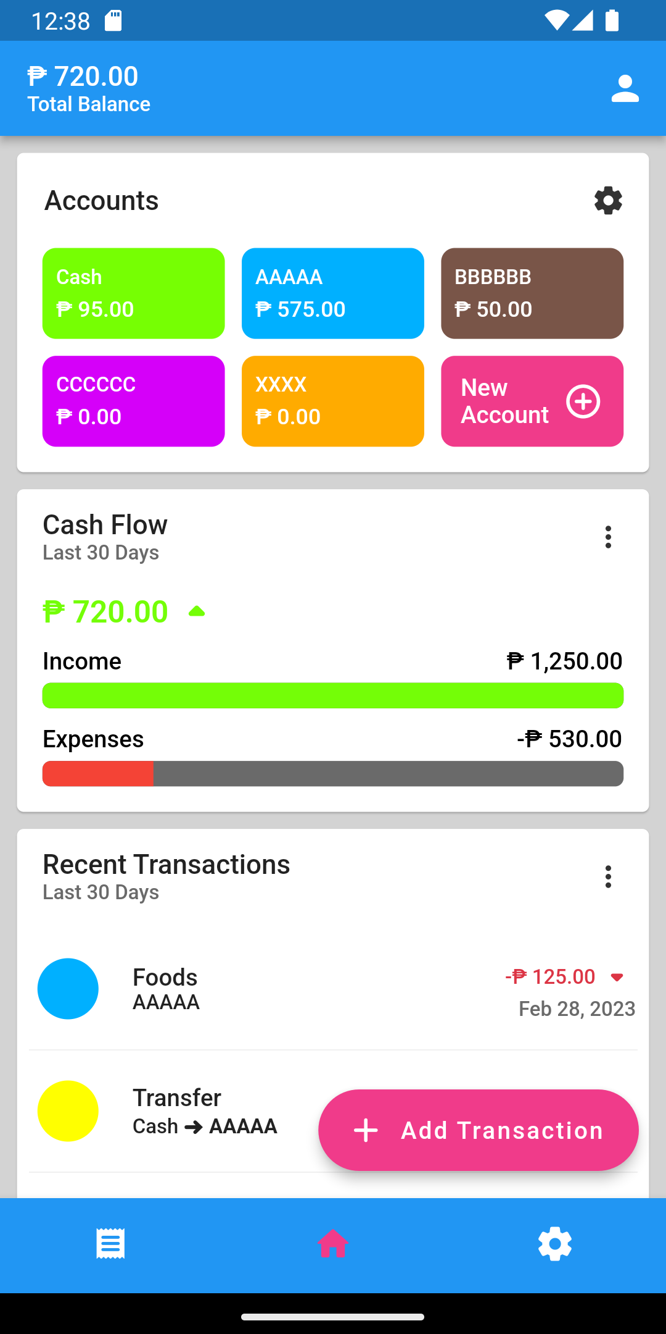
OUTPUT:

Slide 17
